Slide 1
CSE 2050: Final Exam Review

Slide 2
Format of Exam
~20 questions - roughly 1 per objective for last three modules
Question Types:
Multiple Choice
True/False
Multiple answer (select all that apply)
Fill in the blank
Short answer
Technically not “cumulative”, but a strong understanding of the prior material is needed to understand the last three modules

Slide 3
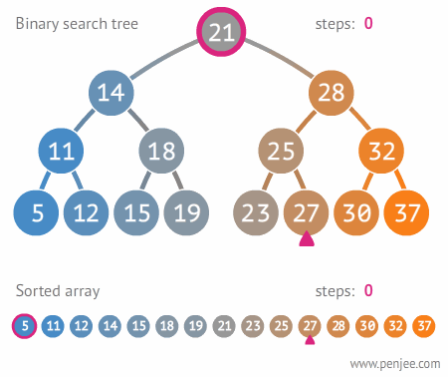
Trees

Slide 4
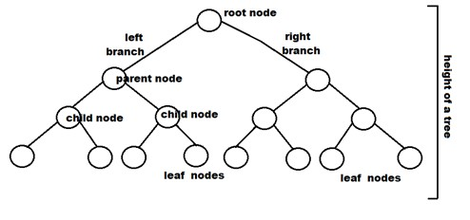
What are trees?
IN BINARY TREES EVERY NODE HAS 2 OR LESS CHILDREN
A Tree is a hierarchical collection of nodes
Root - top node of the tree
Parent - connected one level up
Children - the nodes beneath a parent node
Leaf - node with 0 children
Edge - connection between two nodes
Path - series of edges connecting two nodes

Slide 5
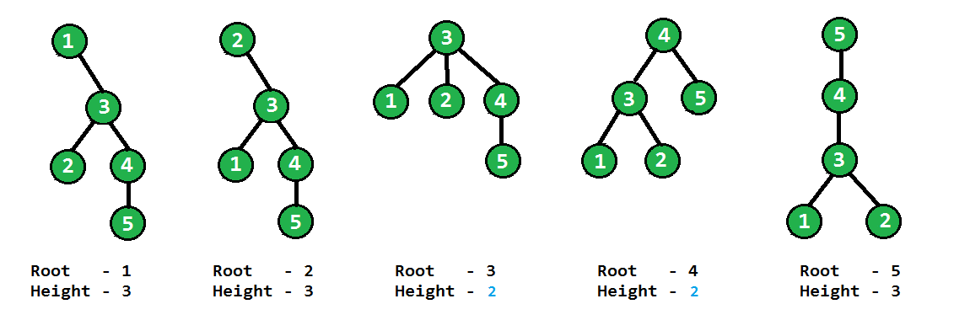
More Vocabulary
Level - the # of edges in the path from the root to the node
Depth - length of the path from a node to the root
Height - the maximum depth of any node in the tree (NOTE: count edges, not nodes!!!!)

Slide 6
Tree traversal
Contrary to linear data structures, trees can be traversed in several different ways
Generating a traversal can be done both recursively and with a stack
3 basic traversals to know about:
Preorder - root, left, right
Postorder - left, right, root
Inorder - left, root, right
Hanna has a good supplemental video on these!
PRACTICE THESE USING A VISUAL TREE ->

Slide 7
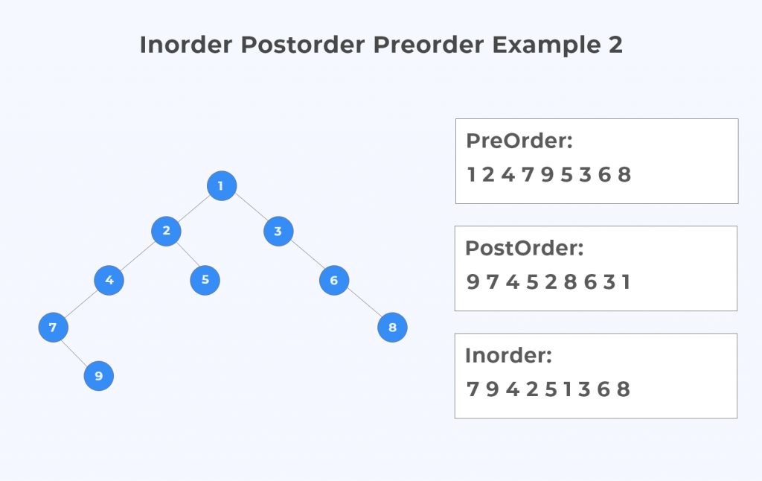
Tree traversal: Example

Slide 8
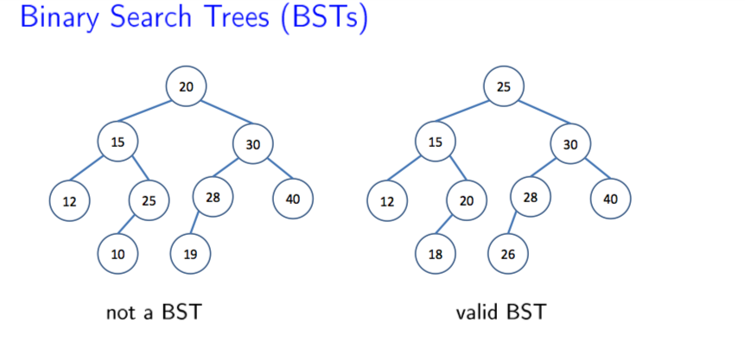
Binary Search Trees
Requirements:
Each node must have between 0-2 children
All items in left subtree are smaller
All items in right subtree are larger
NO duplicates allowed
Ideally, a BST is balanced

Slide 9
Time Complexity
Function | Worst Case, Unbalanced | Worst Case, Balanced
Contains | O(n) | O(logn)
Put | O(n) | O(logn)
Get | O(n) | O(logn)
Floor | O(n) | O(logn)
Remove | O(n) | O(logn)

Slide 10
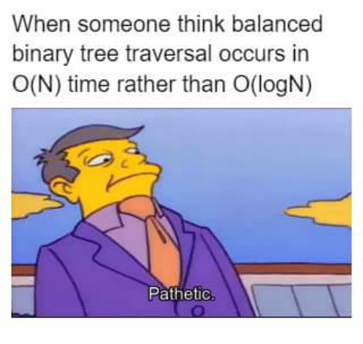

Slide 11
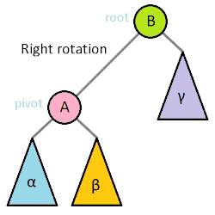
Tree rotations
Why might we want to rotate a BST?
This is a basic restructuring step when it comes to BSTs
We DO NOT want an unbalanced tree - this can throw off our runtimes

Slide 12
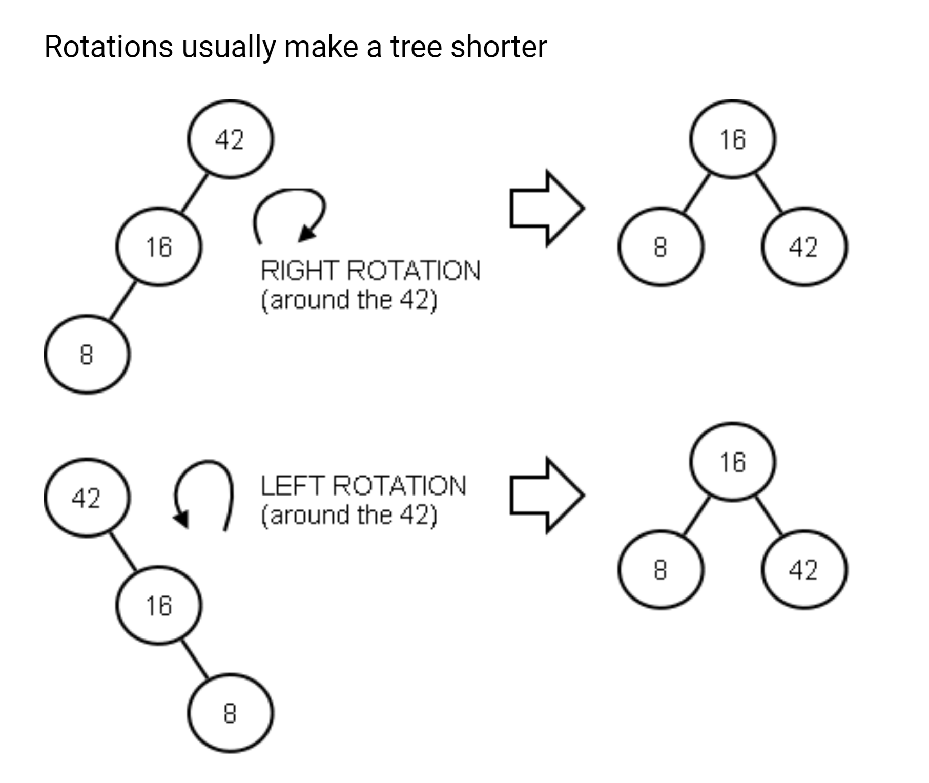
Tree rotations
General rule is to make the new root the median of the numbers
In this case, 16 is the median of 42, 16, and 8
Another way to keep a tree balanced is to rotate after every time you insert a new node

Slide 13

balancing

Slide 14
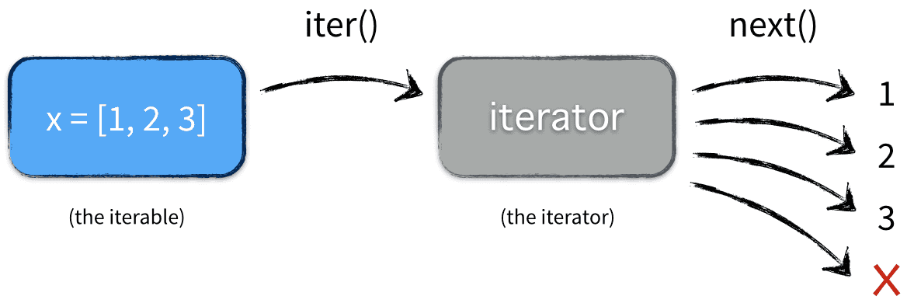
Iterators
__iter__
called with iter()
Produces an iterator
__next__
called with next()
produces the next item in a series
raises StopIteration at end

Slide 15
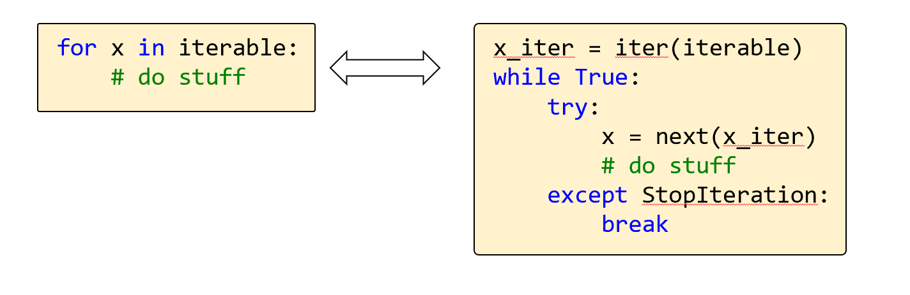
ITER and FOR
A for loop is secretly a while loop in python!
An object has to be iterable for a for loop to be used, because it uses the iter method
Here is what is happening (taken from Jake’s slides lol)

Slide 16
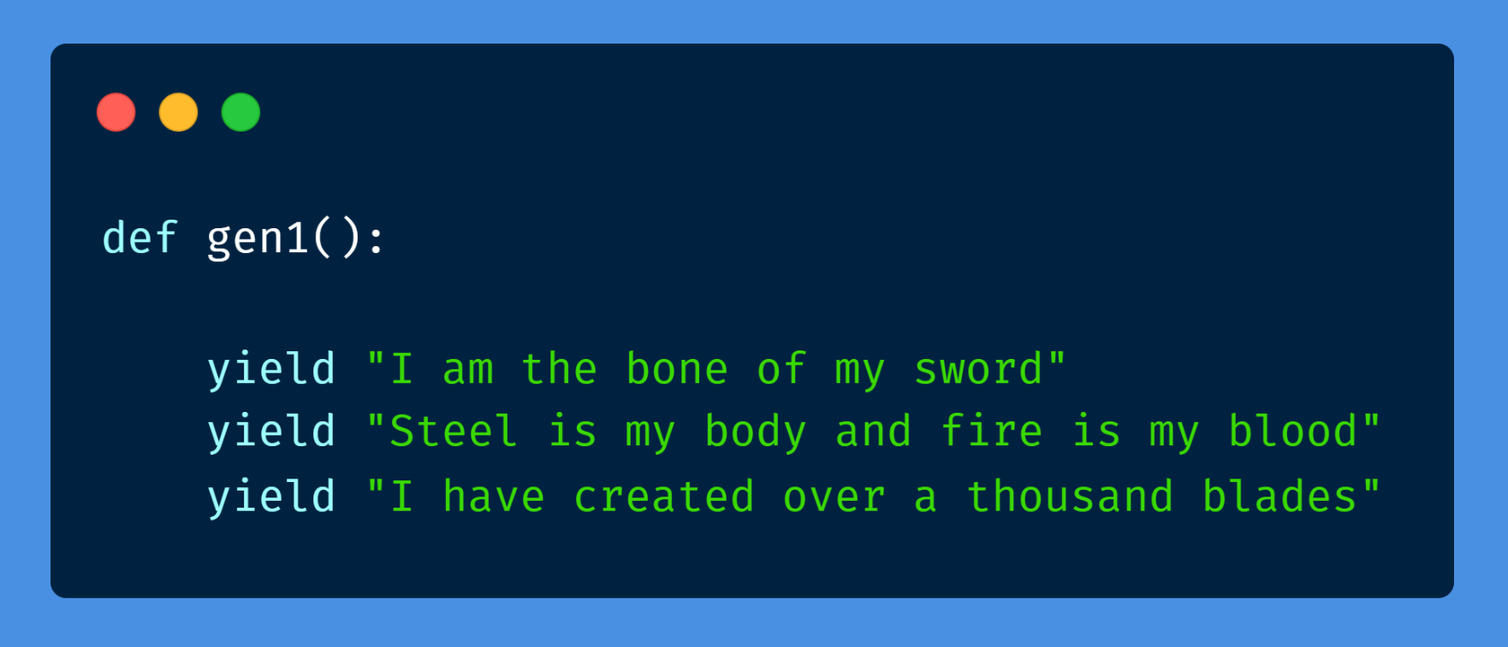
Generators
Generators are a simple/easy way to create an iterator
Every time we want a value generated, we use the built in yield function
Unlike a return statement, a yield statement pauses the function saving all its states and continues from there

Slide 17
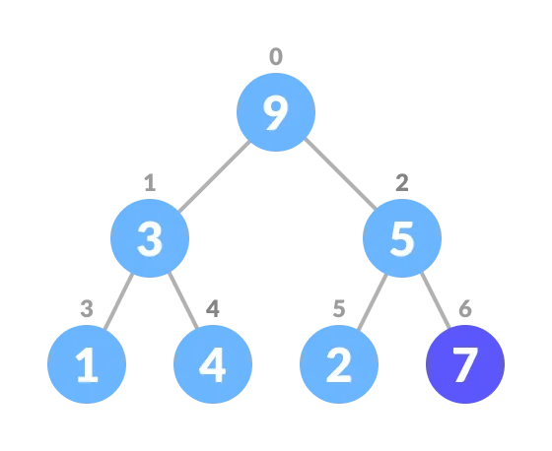
Priority Queues
Module 10

Slide 18
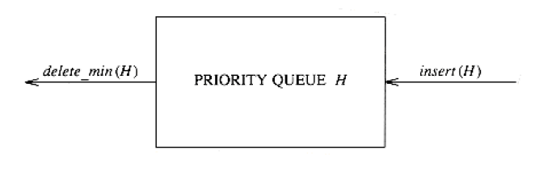
The Priority Queue ADT
Supports the following operations:
insert(item, priority)
find_min()
remove_min()
Extra option:
reduce_priority()

Slide 19
The Priority Queue ADT
SortedList Priority Queue
The running times:
insert
Append in constant time
Handles the one out-of-place element in linear time
find_min
Access last element in constant time
remove_min
Pop last element in constant time

Slide 20
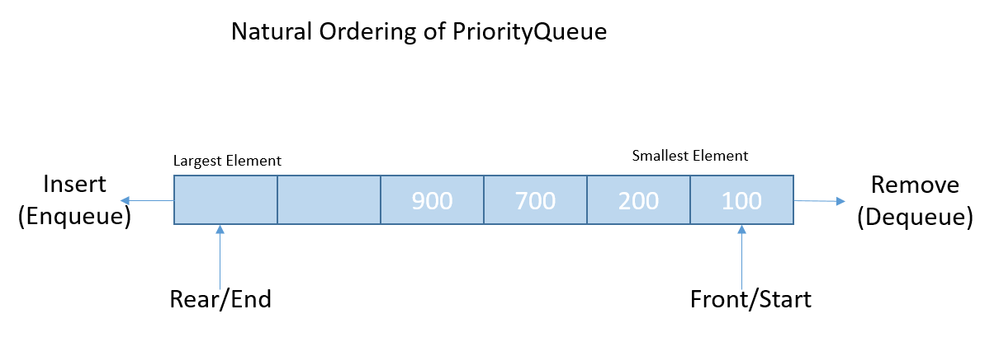
The Priority Queue ADT
SortedList Priority Queue

Slide 21
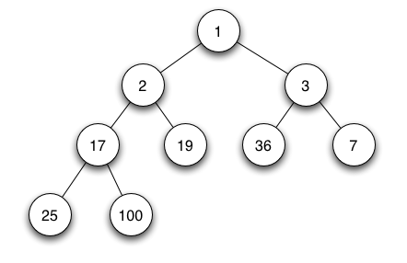
The Heap Data Structure
Priority Queue Implementation
Min Heap Priority Queue
insert O(log n)
find_min O(1)
remove_min O(log n)
Binary Min Heap

Slide 22
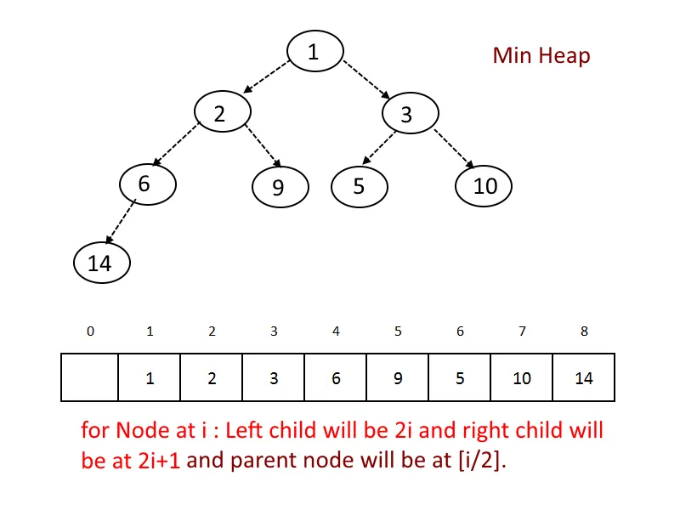
The Heap Data Structure
Binary Min Heap
Complete
All empty spots are at the lowest level, to the right
Binary
All nodes have at most two children
Heap property
No node can have a lower value than its parents
Duplicate values are accepted

Slide 23
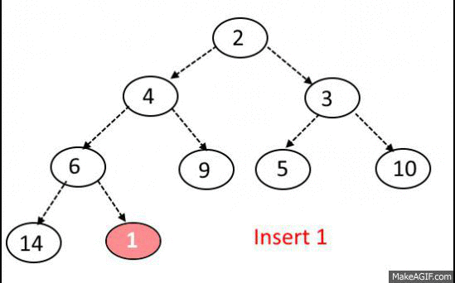
The Heap Data Structure
Insert Element
Insert a new element at the end
Swap with the parent until you respect the heap property
The procedure is called Heapify Up

Slide 24
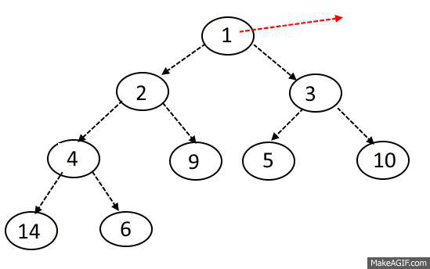
The Heap Data Structure
Remove Minimum Element
Pop the minimum element
Place the last element at the root
Swap with the smallest child until you respect the heap property
The procedure is called Heapify Down

Slide 25
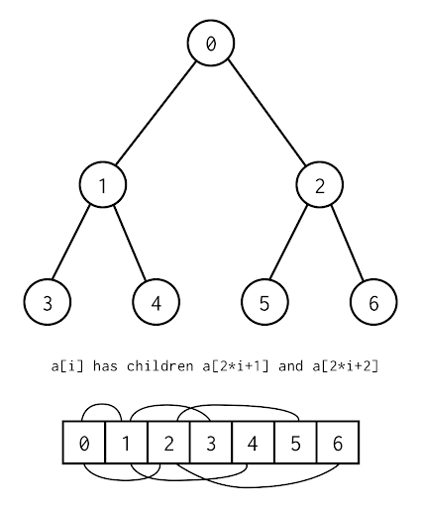
The Array Representation of a Heap
Binary Trees as Arrays
Concept:
Implementation: An Array
Lay out the nodes by level
Next available spot in the tree
Last in the array

Slide 26
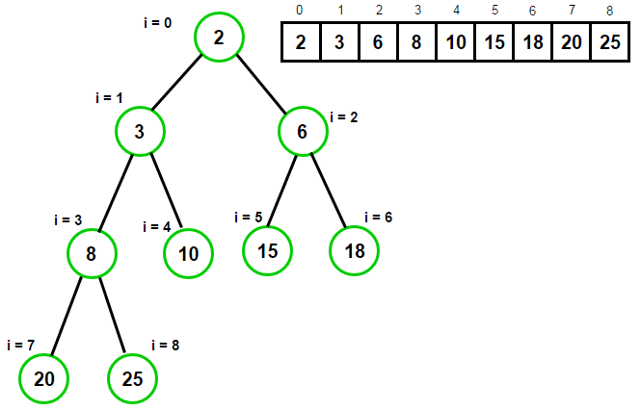
The Array Representation of a Heap
Parents and Children
The node with index i has parent and child according to
Parent: j=(i-1)//2
Left child: j=2*i+1
Right child: j=2*i+2

Slide 27
Graphs

Slide 28
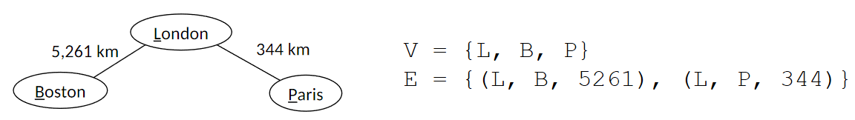
Graphs - Vocab
Graph - set of vertices and edges
Vertices - “nodes”
Edges - connections between two vertices
Can be weighted
If not explicitly weighted, assume weight for each edge is 1

Slide 29
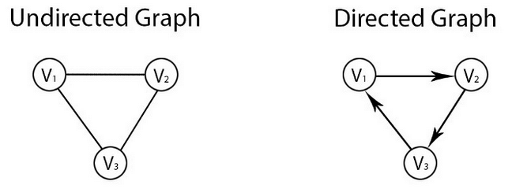
Graphs - More Vocab
Graphs can be directed or undirected
Path - Series of vertices from one vertex to another
Important to consider directionality
Cycle - A path that starts and ends at the same vertex
Two nodes are connected if there is a path from one vertex to the other

Slide 30
Graph ADT
Important Graph Methods
__init__(V, E) - creates a graph with vertex and edge sets V and E
add_vertex(v) - adds vertex v to graph
remove_vertex(v) - removes vertex v from graph
add_edge(u, v) - adds edge (u, v) to graph
remove_edge(u, v) - removes edge (u, v) from graph
neighbors(v) - returns iterable collection of v’s neighbors
Running time dependent on graph representation
It is important to recognize that these methods may look very different depending on the graph representation chosen (next slide)

Slide 31
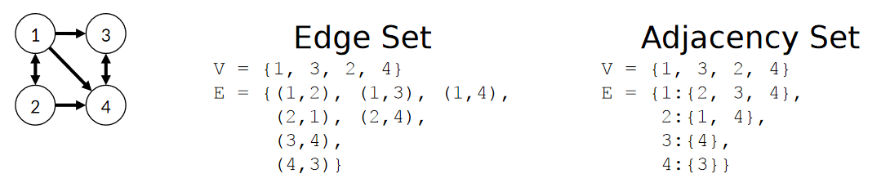
Edge Set vs Adjacency Set
Edge Set
Adjacency Set
Set of vertices
Set of edges
Set of vertices
Dictionary of neighbors

Slide 32
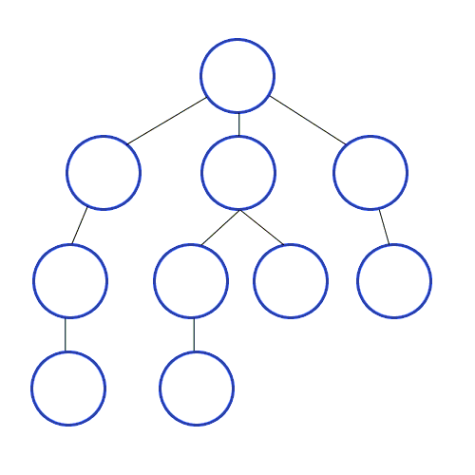
DFS VS BFS
Depth First Search
Breadth First Search
implemented using a Stack
Implemented using a Queue
Both have time: O(m+n)

Slide 33
Dijkstra’s and Prim’s ALgorithms
Dijkstra’s
Prim’s
Finds the shortest paths from one node to all the other nodes in a weighted graph
Finds the minimum spanning tree - cheapest set of edges that connect all vertices
Both utilize a Priority Queue
Both have time: O(m log n)
Check out Prof. Hanna’s videos on the Graph Algorithms

Slide 34
Applications of Dijkstra’s and Prim’s
Dijkstra’s
Prim’s
Shortest distance between cities
IP routing - link state routing
Network design
Least amount of cable for network
Overnight snow removal
Clear minimum total distance
Flight routes
Maintain cheapest set of routes that connect all cities

Slide 35


Link for game host
Have fun! - Tom

Slide 36


It has been a hard semester, but
Finish off strong!!!!!
Remember these inspirational Rupaul images

